Slide 1


Predicting NBA Basketball Player Salaries
Presented By: Yilin Gong, Songyao Hou,
Yulin Li and William DeForest

Slide 2




Team Members
Yilin Gong
Founder, Data Scientist
Songyao Hou
Founder, Data Scientist
Yulin li
Founder, Data Scientist
William DeForest
Founder, Data Scientist
gongy@uchicago.edu
sh5584@uchicago.edu
leoli0907@uchicago.edu
wdeforest @uchicago.edu

Slide 3

Agenda
01
04
02
05
03
Executive summary
Analytics & Results
Data Ingestion & Prep
Conclusion & Extensions
Data Modeling & Design

Slide 4
Executive summary

Slide 5
Executive Summary
Objective:
Our primary goal is to predict NBA players' salaries using physical attributes and statistics
Business Use Case/Purpose:
Assist NBA front offices in player valuation.
Optimize payroll management and team composition.
Data Sources:
NBA API (GitHub): For player characteristics and in-game data.
Hoopshype.com (NBA Salaries 1990-2023): For salary information.
Runrepeat.com (Team Financials): For NBA team revenue, ticket sales, and operating income
Methodology:
Data collection via API and web scraping using Python Requests and Beautifulsoup libraries.
Data cleaning in Python using Pandas library.
Data integration using SQL.
Analysis with Python Pandas library.

Slide 6
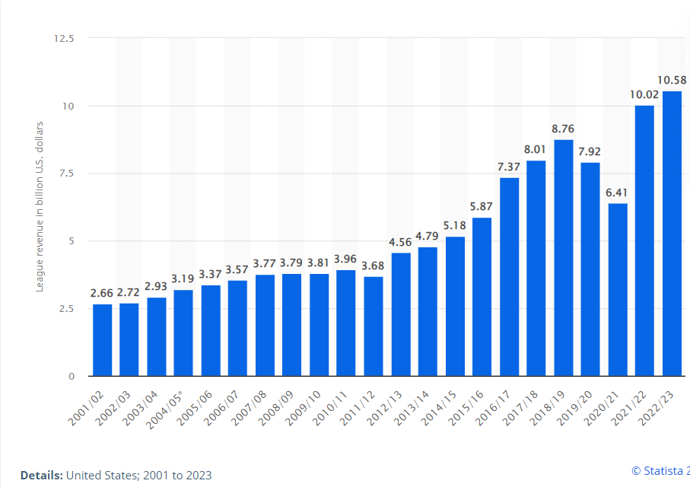
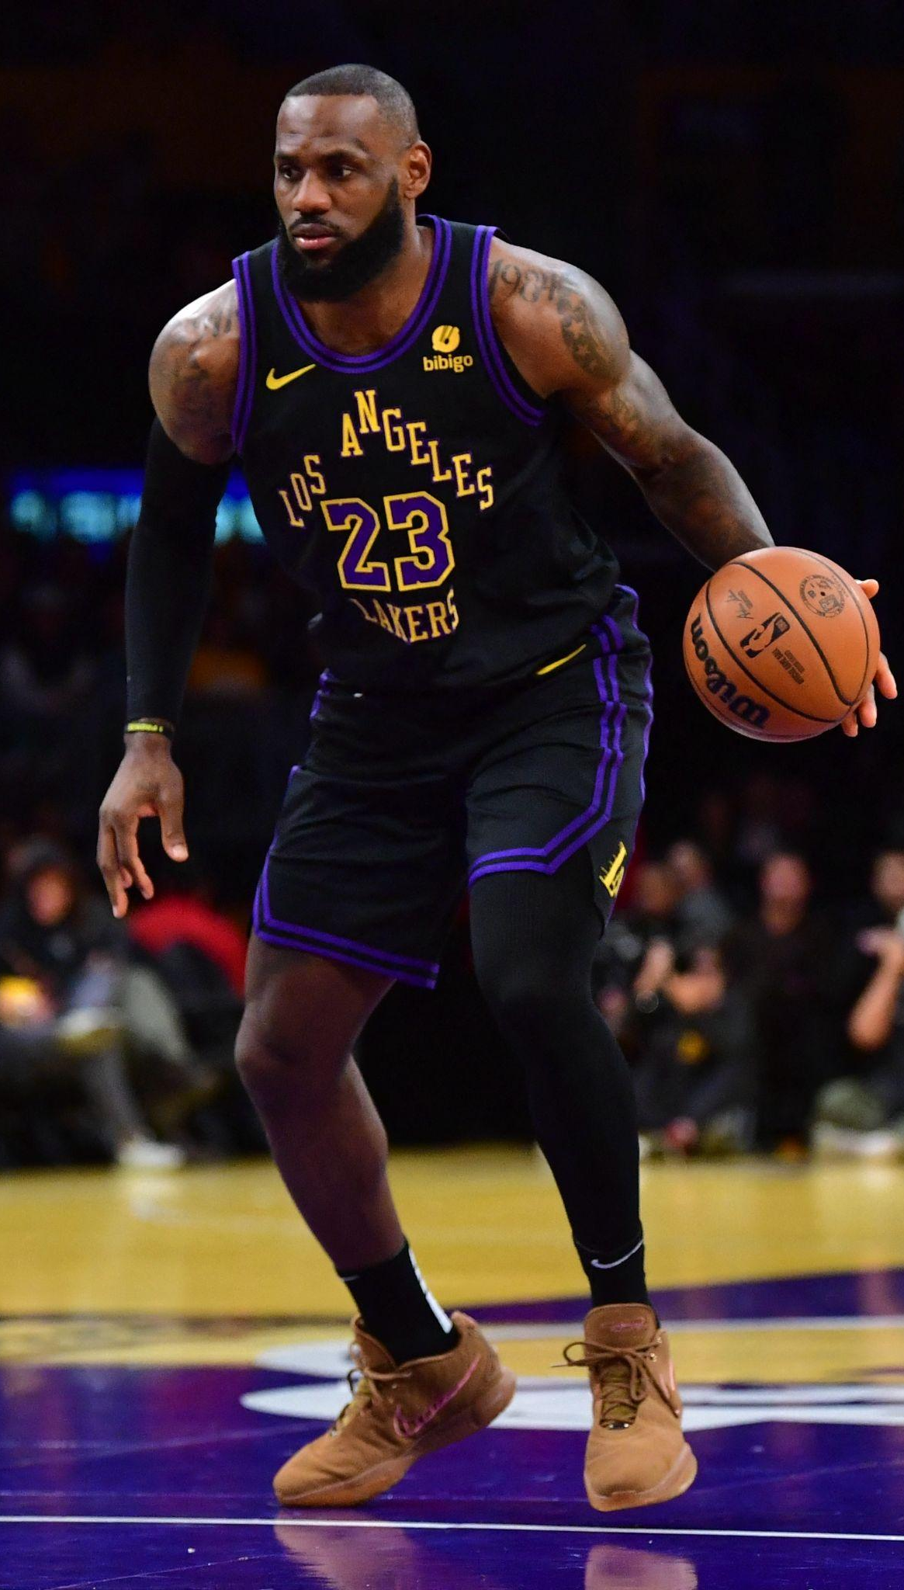

What is the NBA?
National Basketball Association
2nd most popular sport in the U.S.
$10.58 billion of revenue in 2023
30 teams competing for tens of millions of dollars

Slide 7
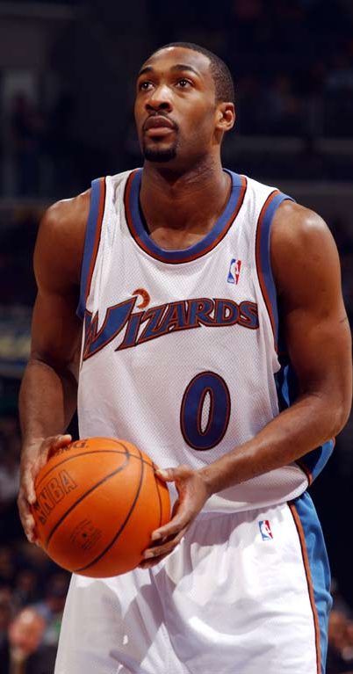
Business Use case
Actor | Incentive | Business Use
NBA Team Front Office | Save time Manage risk | Understand the value of the player and help the team decide how big of a salary they should offer the player.
Coach | Identify the ideal position for a player | Assist them in determining the most suitable position or role for that player within the team.
Fans | Teams who make wiser financial decisions perform better. As a result, fans of the wiser teams will benefit. | Fans can use our findings to judge the player/business decisions their favorite teams are making. This will make them feel more engaged and can help them be a more informed fan
NBA player | Save time Maximize income | Players can use our findings to better understand their worth and negotiate for a higher salary.

Slide 8
Data Ingestion & Preparation

Slide 9
Solution Overview: Data & Tools
Main Datasets
Data Connectors
Data Processing
& Storage
Visualizations
Player Statistics
Points scored, games & minutes played, etc
Player Bio
Height, weight, birthdate, college, etc
Player Salaries
Salary & inflation adjusted salary
NBA.com
Nba_api by Swar Patel
Hoopshype.com
Python web scraping
Runrepeat.com
Python web scraping of post by Dimitrije Curcic
Python
Matplotlib
Seaborn
Tableau
Python
Data cleaning and processing
Excel
Data cleaning and processing
MySQL Workbench
Database design
GCP MySQL
Data storage and sharing
Analytics
Python
Pandas
Numpy
Tableau
Supporting Datasets
NBA Teams
Name, city, year founded
Team Financials
Revenue, ticket sales, operating income

Slide 10
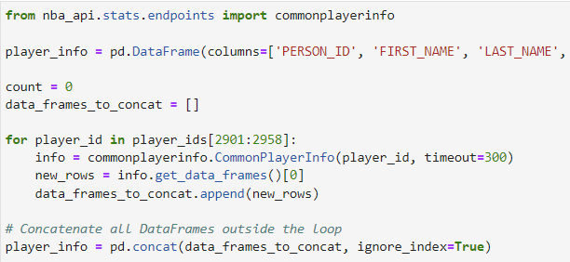
Data Ingestion - NBA API
NBA API Data Requests
Code To Access The API
Used nba_api Python package by Swar Patel to access the APIs of NBA.com
https://github.com/swar/nba_api
Endpoints used:
Stats: playercareerstats
Player Info: commonplayerinfo

Slide 11
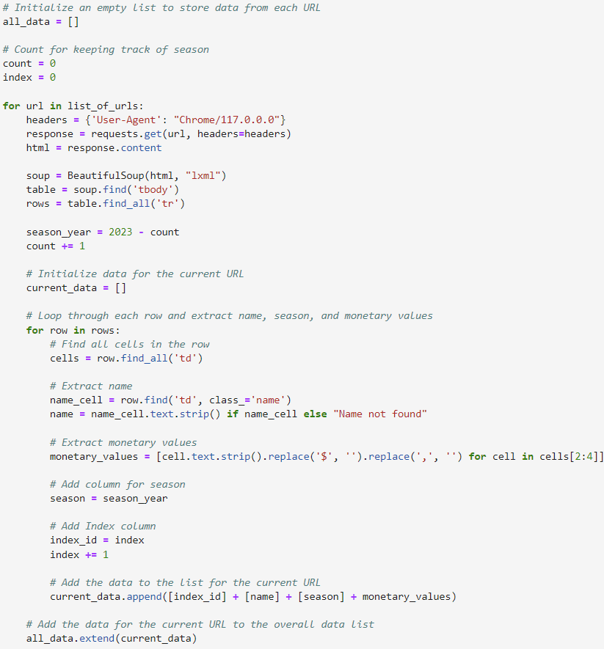
Data Ingestion - Web Scraping Salaries
Web Scraping Salaries
Code to Scrape Salaries
Used requests and BeautifulSoup Python packages to web scrape player salaries
https://hoopshype.com/salaries/players/
Using a for loop, scraped data for all seasons available (1990-2023)

Slide 12
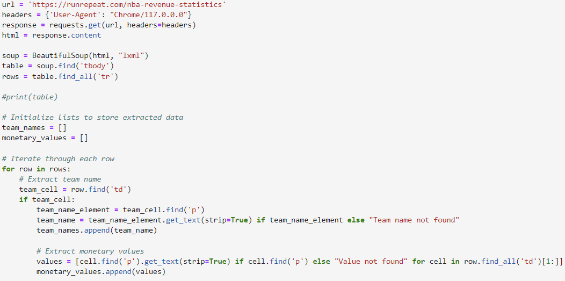
Data Ingestion - Scraping Team Financials
Web Scraping Team Financials
Code To Scrape Team Financials
Used requests and BeautifulSoup Python packages to web scrape team financials
https://runrepeat.com/nba-revenue-statistics
Performed separate scrapes for team revenue, team ticket revenue, and team operating income

Slide 13
Collected Data Profiles
Dataset | Data Source | Format and Size | Features | Platform and Tools Used
Player Statistics | NBA API | Structured CSV (30,000 rows and 28 cols) | Games played, minutes, FG_PCT, FGA, rebounds, assists, points scored | MySQL, Python, Excel
Player Bio | NBA API | Structured CSV (2,900 rows and 27 cols) | Age, height, weight, country, college, draft pick, position | MySQL, Python, Excel
Player Salaries | hoopshype.com | Structured CSV (14,600 rows and 6 cols) | Salary, inflation-adjusted salary | MySQL, Python, Excel
Team Info | NBA API | Structured CSV (30 rows and 7 cols) | Team name, city, state, year founded | MySQL, Python, Excel
Team Financials | Runrepeat.com | Structured CSV (300 rows and 7 cols) | Team revenue, ticket revenue, operating income | MySQL, Python, Excel

Slide 14
Data Transformations
Dataset | Transformations | Reason | Tools Used
Player Statistics | Re-formatted the SEASON var. from ‘1990-91’ format to 1990 | Needed format to match SEASON columns in our other tables | Python
Player Bio | Dropped redundant columns and created a ‘Demographic_ID’ index to use as a primary key | Redundant columns are a waste of resources and we needed a unique identifier for each row | Python, Excel
Player Salaries | Joined PLAYER_ID from Player Bio table on player name using exact matching algorithm. | Needed PLAYER_ID to relate salaries to players. | Python
Team Info | Renamed columns to match naming conventions | Easier to relate different tables to each other if columns have the same names and naming conventions | Python
Team Financials | Converted individual revenue, ticket sales, operating income tables from wide to narrow format. Joined on team name and season. | Wanted to combine the three financial metrics into a single table where each observation is a team’s financial metrics for a given season | Python, Excel

Slide 15
Data Modeling & Design

Slide 16

Design Considerations
Data Types
IDs: INT
SEASON: INT
BIRTHDATE: DATETIME
Names: VARCHAR
Height: VARCHAR
Stats: INT/DECIMAL
Dealing with NAs
Missing primary key:
Drop NA
PKs cannot be NULL
Missing foreign key:
Keep NA
A NULL FK just means that obs. won’t be related to the other table
Other missing values:
Keep NA
OLTP vs. OLAP
- Normally, for an analytical application such as this, an OLAP structure is optimal
- However, we ultimately chose to use OLTP. Why?
Clearer links between tables which is imp. for users who need nuanced queries
Size of data is not so large that OLTP will slow down queries
Data Quality Metrics & Practical Considerations
- Metric 1: Impact on salary from different statistics
- Metric 2: Relationship between player salary and team performance
- Hardware/software: No need for physical servers. We will use GCP on our laptops
- Number of users/location: 4 users who need to be able to access from dif. locations

Slide 17
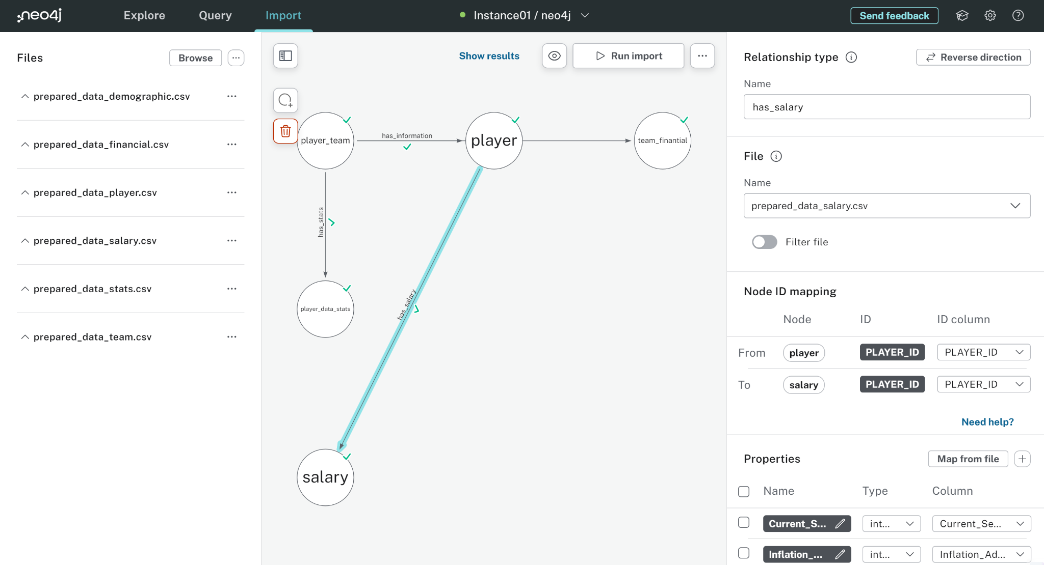
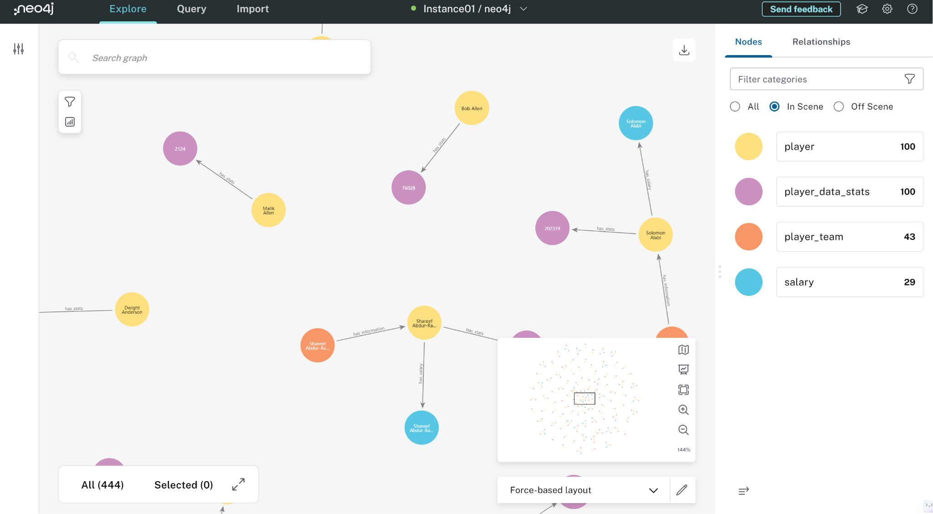
NoSQL Database - Neo4J
Graph Database Model
Neo4J is ideal for representing the intricate relationships in NBA player data. Nodes can represent entities such as players, teams, and stats, while relationships capture interactions like playing for a team in a specific season, or playing for a team having specific stats.
Efficient Relationship Queries
Neo4j's native graph traversal capabilities enable efficient querying of relationships. This is advantageous when analyzing player-team interactions, historical performance, and other complex patterns in NBA data.
Scalability
Neo4j's ability to scale horizontally makes it suitable for handling the growing volumes of NBA player data. As the dataset expands, Neo4j can accommodate the increased workload while maintaining performance.

Slide 18
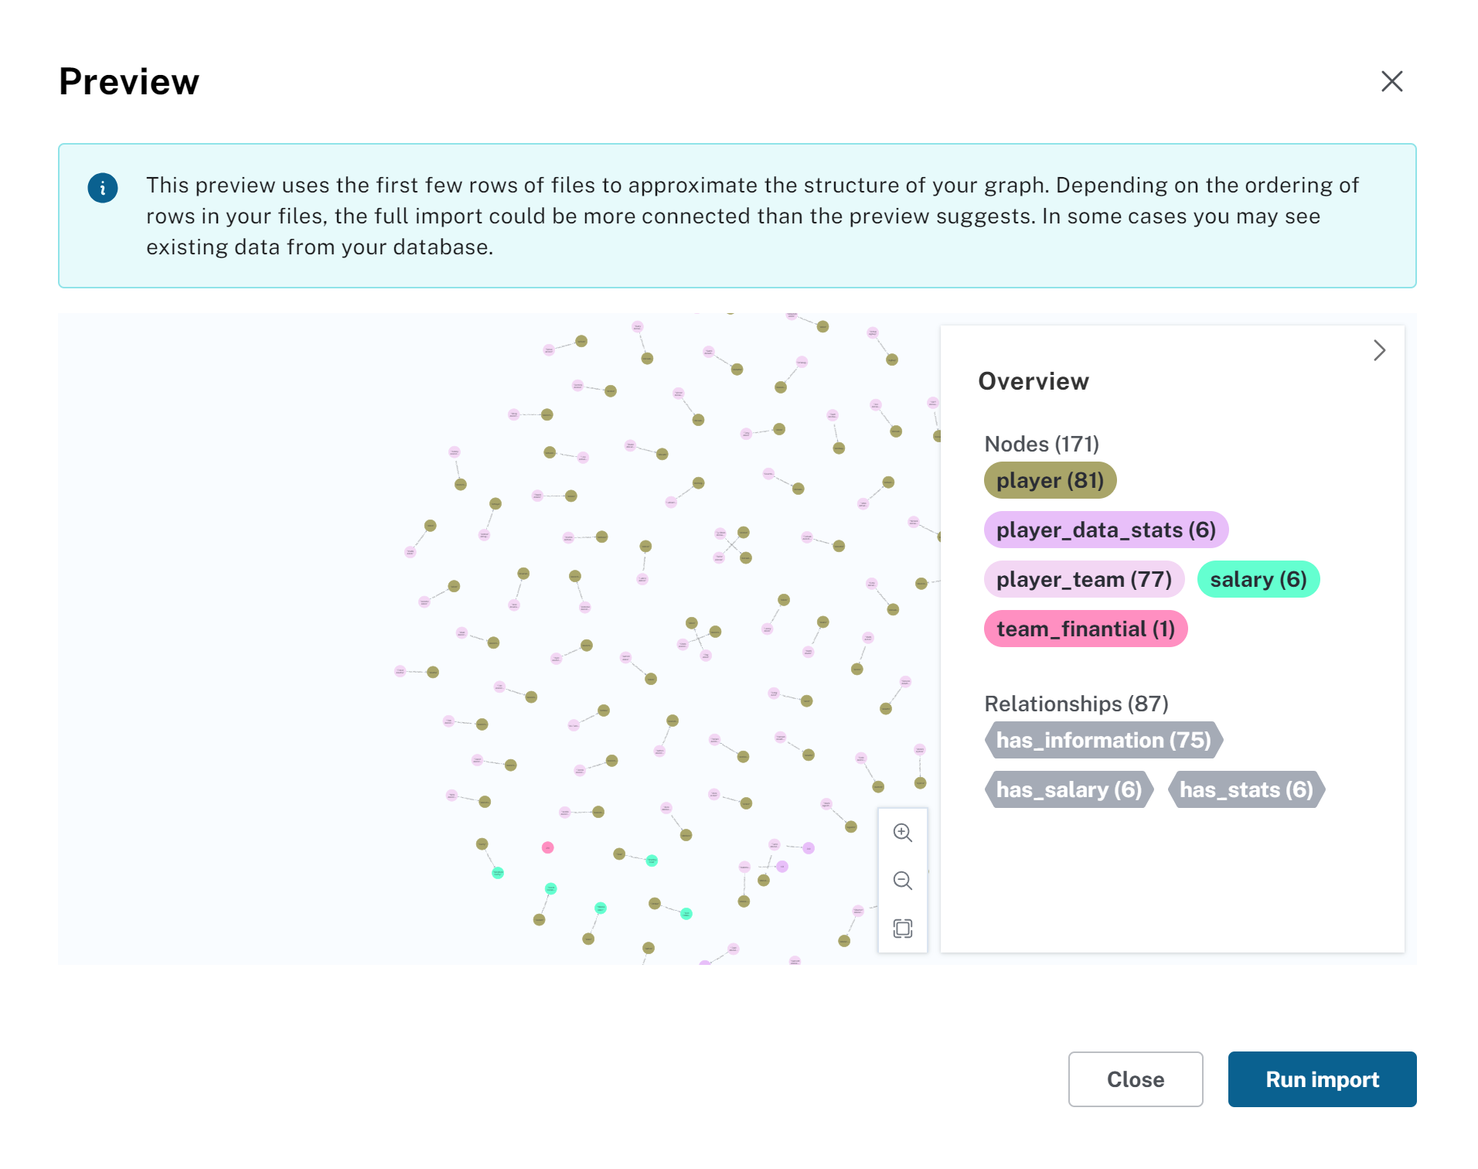
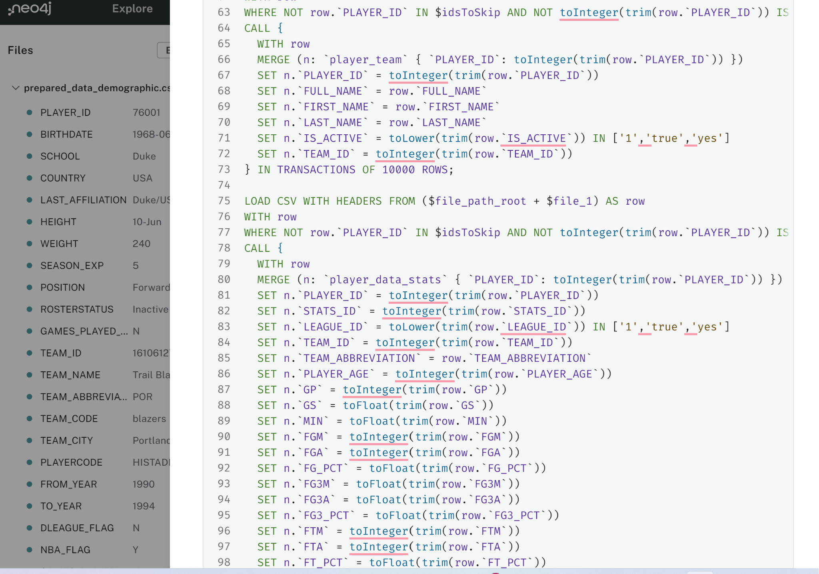
NoSQL Database - Neo4J
Preview on first few rows
Part of our cypher script

Slide 19
Database Design Process
Conceptual Database Model
Entities: Player, Stats, Demographics, Salary, Team, Team Financials
Relationships: Stats, Demographics, and Salary related to Player by PLAYER_ID
Relationships: Player and Team Financials related to Team by TEAM_ID
Logical Database Creation
Primary Keys: Each table will have a unique primary key ‘TABLE_NAME’_ID
Foreign Keys: Player_ID will be a FK for Stats, Demographics, and Salary. TEAM_ID will be a FK for Player and Team Financials
Normalization: Data normalized to 3NF
Software: Using MySQL Workbench to design and GCP to share
Physical Database Creation
Wrote a DDL (Data Definition Language) script in MySQL Workbench to define our database structure
Tested in MySQL Workbench, then loaded our DDL script and datasets (as CSVs) into Google Cloud Platform (GCP)
Created a MySQL instance in GCP, connected each of our IP addresses, ran the DDL and uploaded our data to establish a shared database
GCP greatly enhances the automatability of our end to end pipeline. Through GCP we can handle security, backup, monitoring, updating, schema and migration scaling

Slide 20
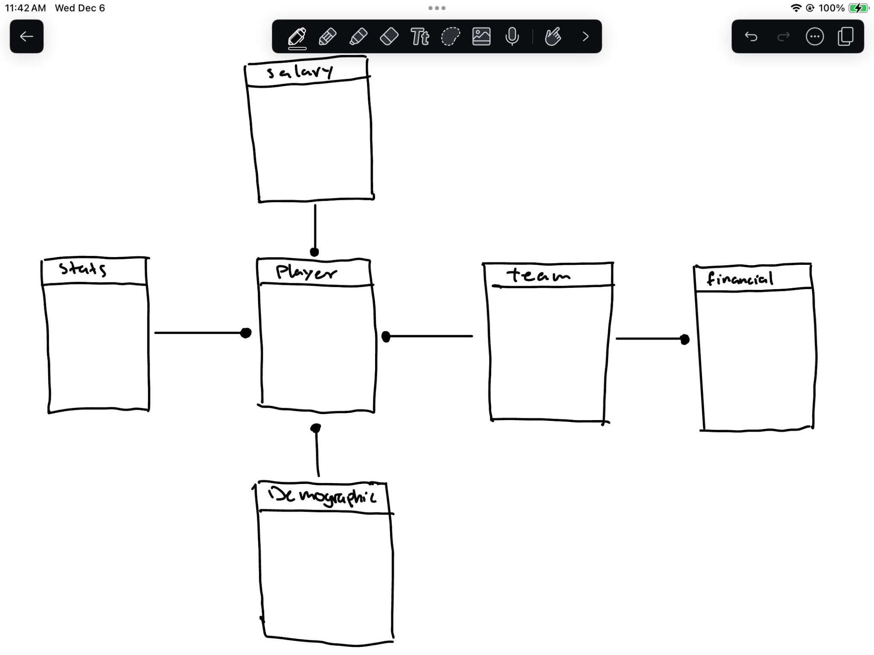
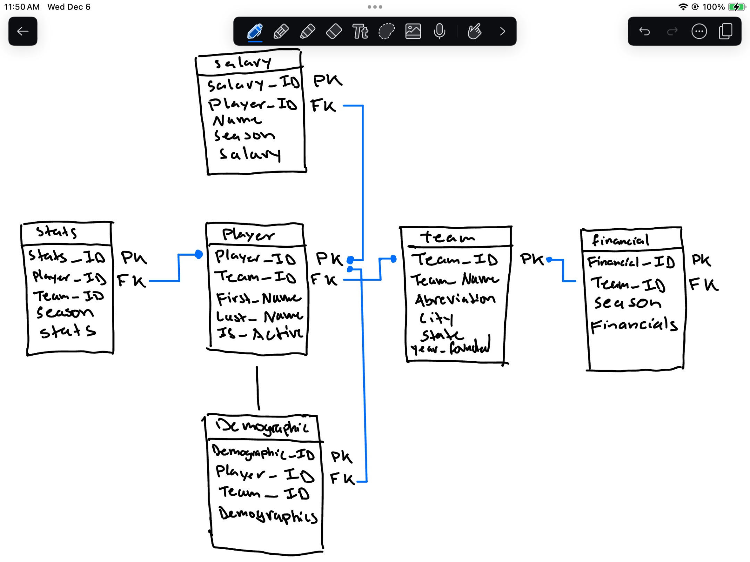
Database Modeling - Conceptual & Logical Model Design
Conceptual Model
Logical Model

Slide 21
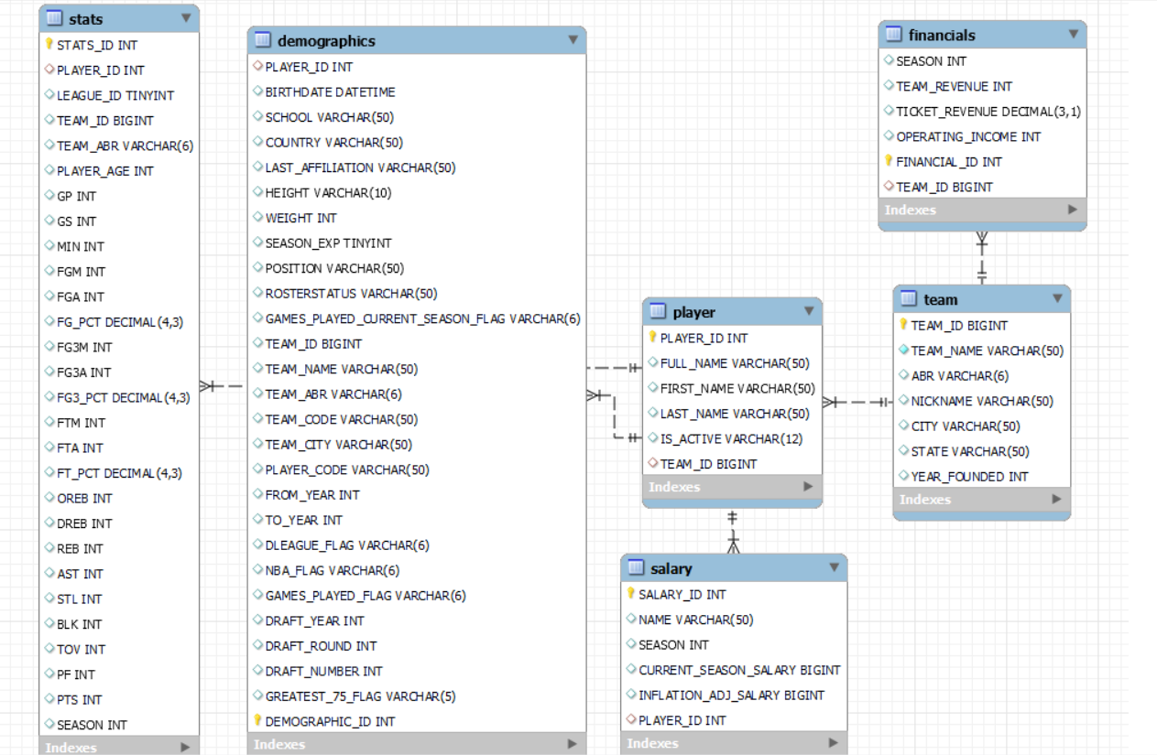
Database Modeling - EER Model

Slide 22
Data Quality
Completeness:
Basic player info highly complete (PLAYER_ID, FULL_NAME).
Significant gaps in TEAM_ID, BIRTHDATE, performance stats (GP, PTS, MIN).
Financial data largely missing (over 46,000 missing entries for TEAM_REVENUE, TEAM_TICKET_REVENUE, etc.). NBA teams are not public companies, so availability of this data is limited
Validity:
Data types and formats appear valid.
Extensive missing values may impact overall dataset validity for comprehensive analysis.
Uniqueness:
No duplicates; player identification is unique (based on PLAYER_ID, FULL_NAME).
Consistency:
Consistent formatting across columns.
Missing values may impact longitudinal or comparative consistency.
Timeliness:
Timeliness not directly accessible; inclusion of recent seasons would enhance relevance.
Accuracy:
Accuracy generally acceptable but not externally validated.
Missing data may affect accuracy for specific analyses.

Slide 23
Analytics & Results

Slide 24
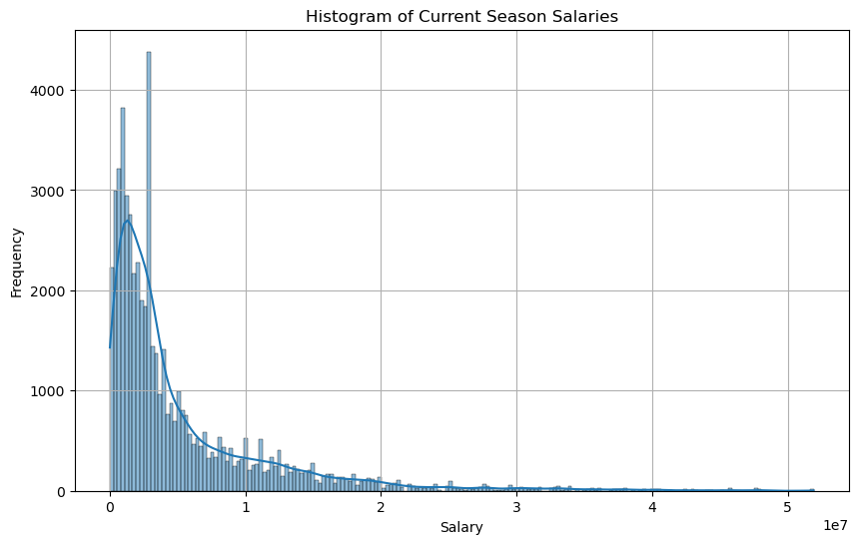
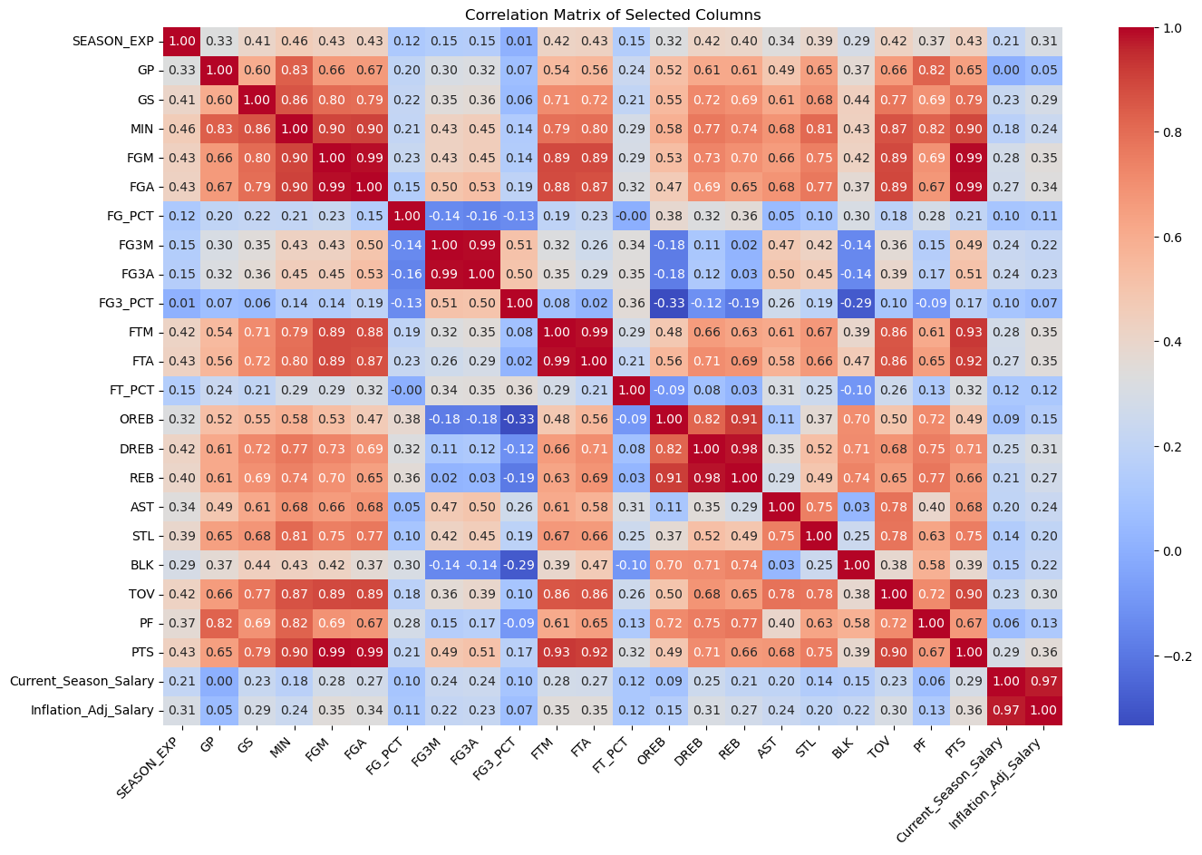
Analysis
Salary Distribution Overview:
Majority of player salaries are concentrated on the lower end.
Graph illustrates skewed distribution towards lower salaries.
Correlation with Team Revenue:
Analysis of salary vs. team revenue.
Weak or no significant correlation observed.

Slide 25
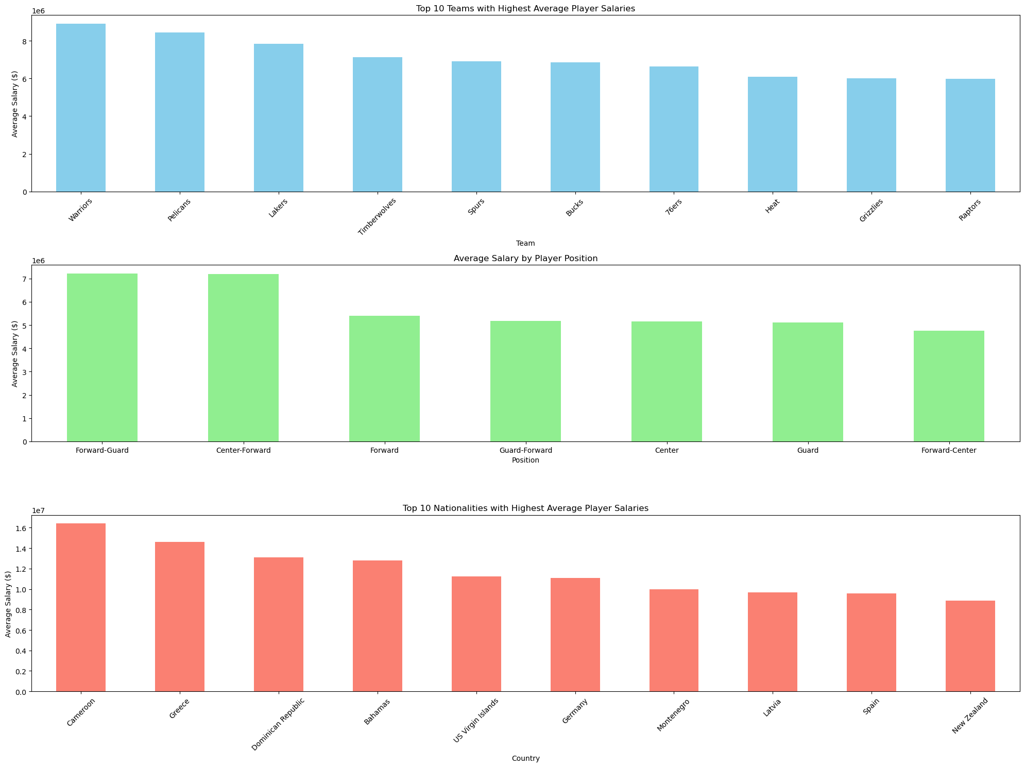
Analysis (Team)
The graphs display average player salaries by team and by position. The first graph shows a slight decrease in average salaries from the team with the highest (possibly the Warriors) to the lowest among the top ten teams. The second graph indicates that players in the Forward-Guard position earn the most on average, while Centers earn the least. Salaries by position are less variable than by team, suggesting that player roles have a standardized market value across the league.

Slide 26
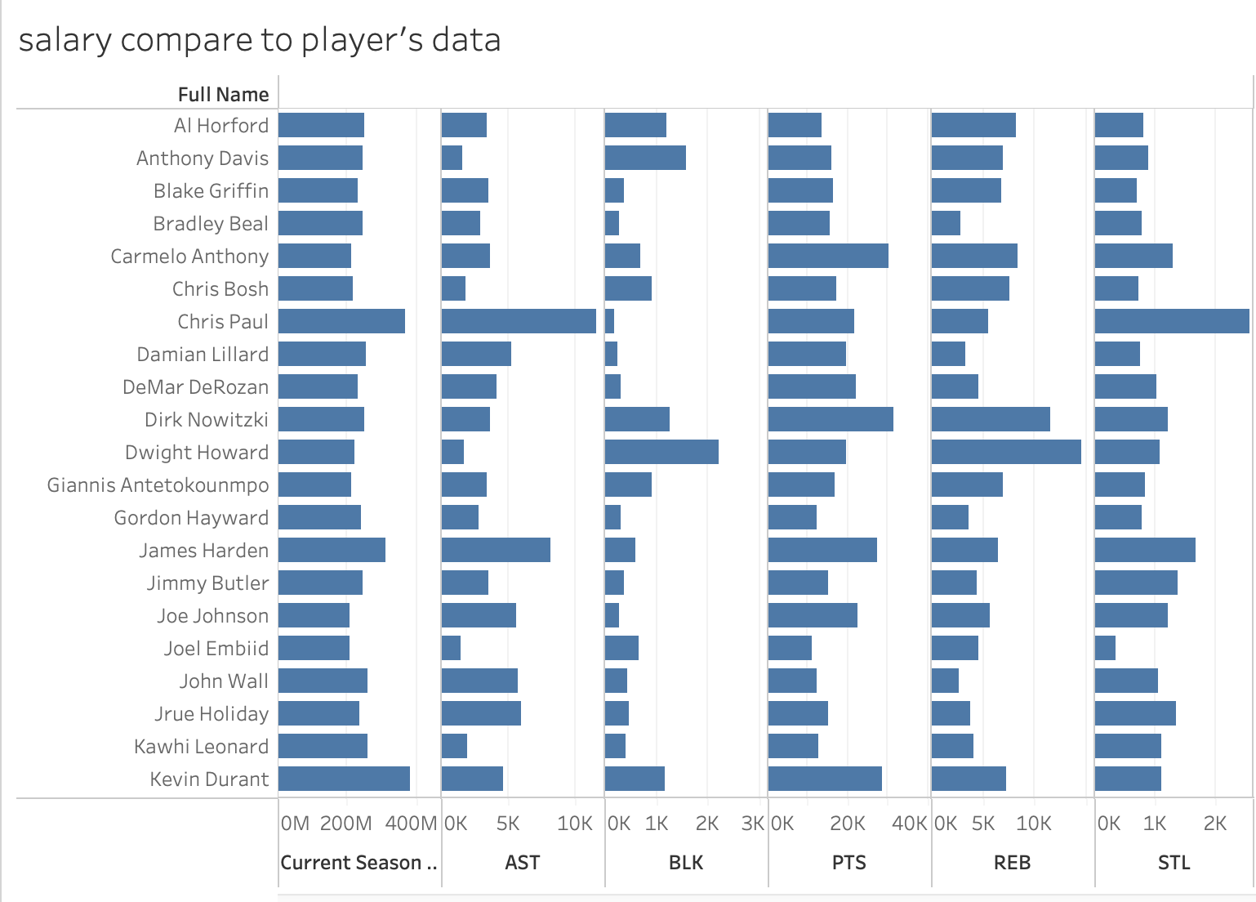
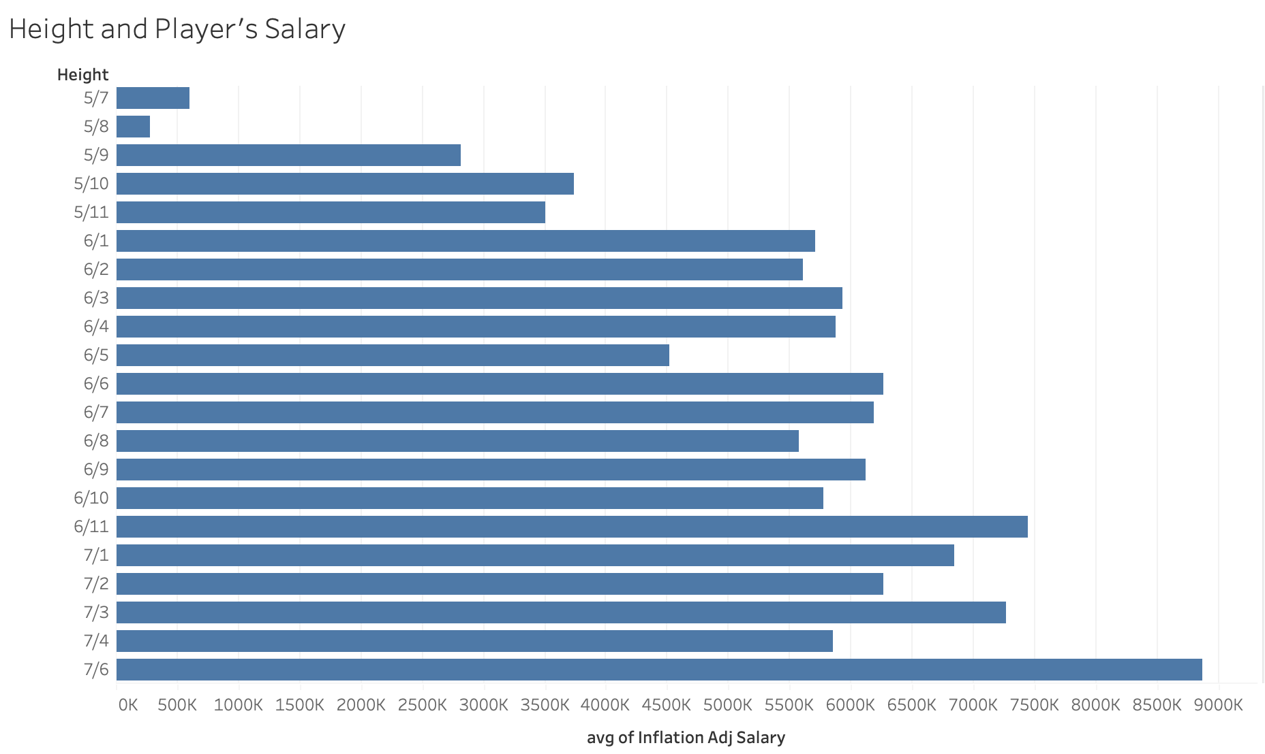
Data visualization

Slide 27
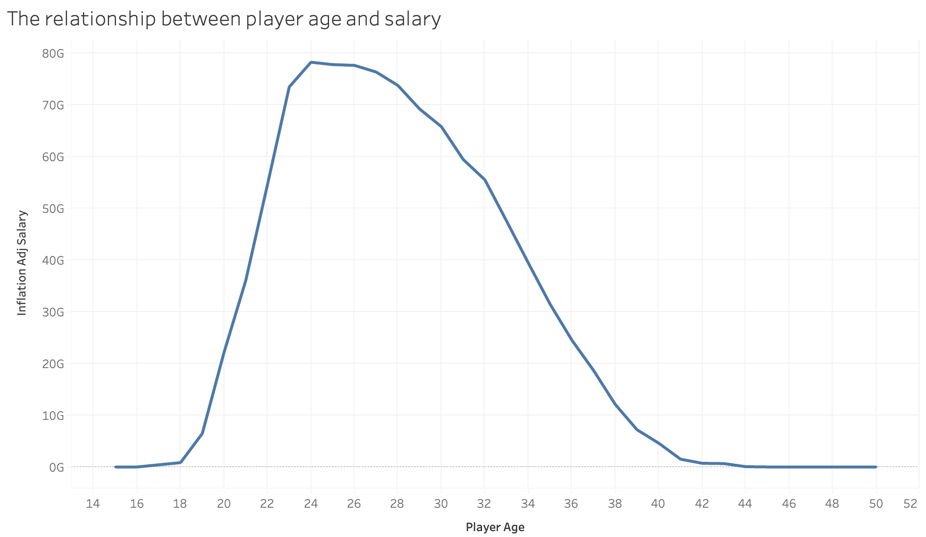
Data visualization

Slide 28
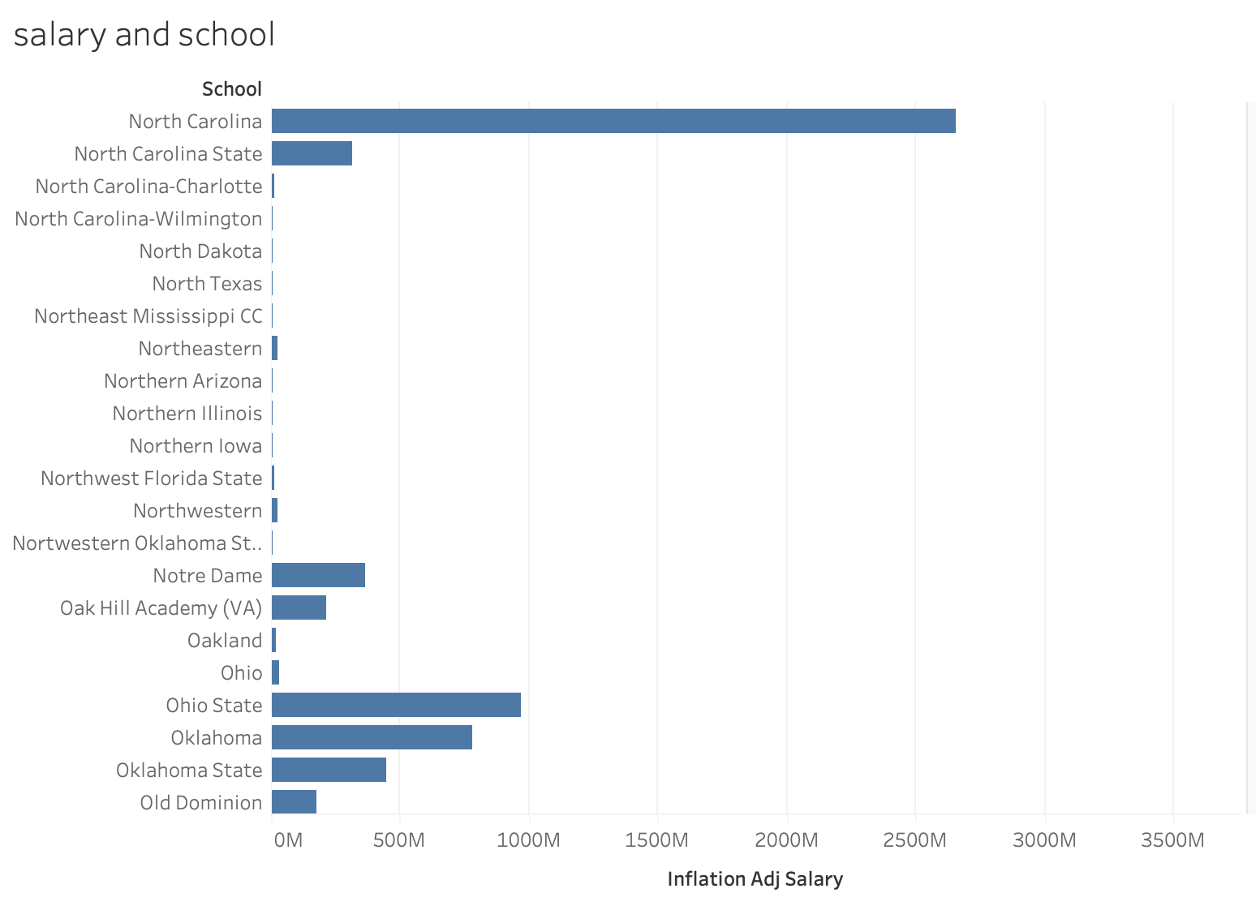
Data visualization
There are also strong relation between the player’s salary and their school. Some of the school having better resources and give their player more chance to show what they can do and more chance to get into NBA, and gaining more salary.

Slide 29
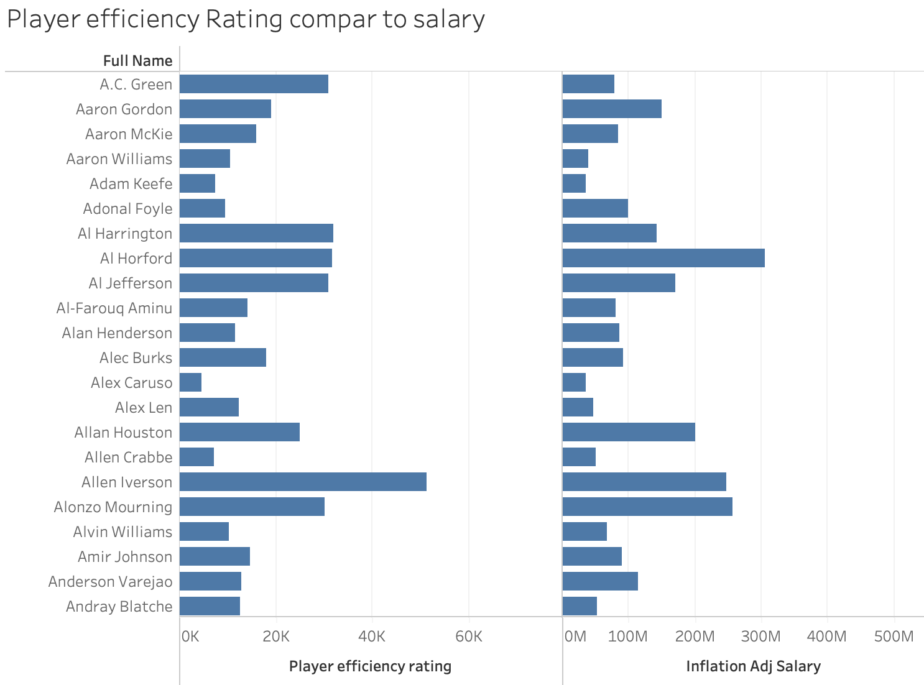
Data visualization
PER, or Player Efficiency Rating, evaluates a player's performance by considering both positive and negative on-court actions. Positive contributions like field goals, free throws, 3-pointers, assists, rebounds, blocks, and steals are added, while negative outcomes such as missed shots, turnovers, and personal fouls are subtracted. This approach uses a point value system to quantify each stat. This is one of the data that can shows how player can do on the court. There are a lot player’s are having high wage than others but not have good enough efficiency rat. Which we can help those people who have a high efficiency rat to gain more salary.

Slide 30
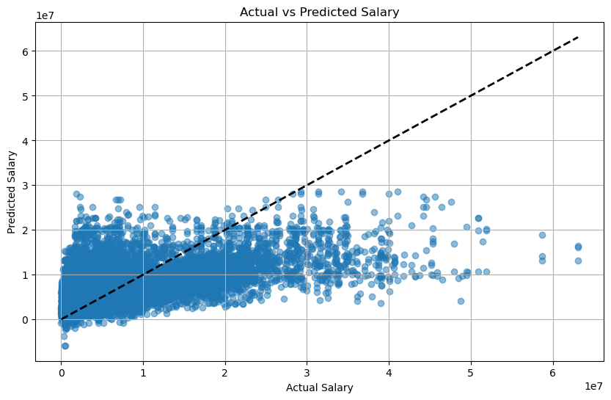
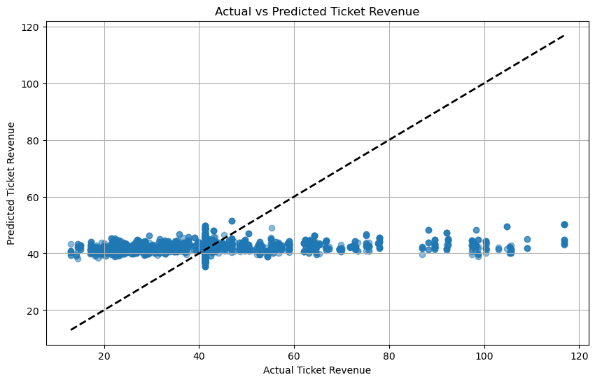
Analysis (Regression)
Player Performance Statistics:
Examination of the link between player performance and salaries.
No strong correlation identified.
Regression Model Insights:
Model Used: Regression analysis to quantify relationship.
R² Value: 0.27, indicating a poor model fit.
Conclusive Remarks:
The analysis supports the initial hypothesis: negligible relevance between player salaries and their performance

Slide 31
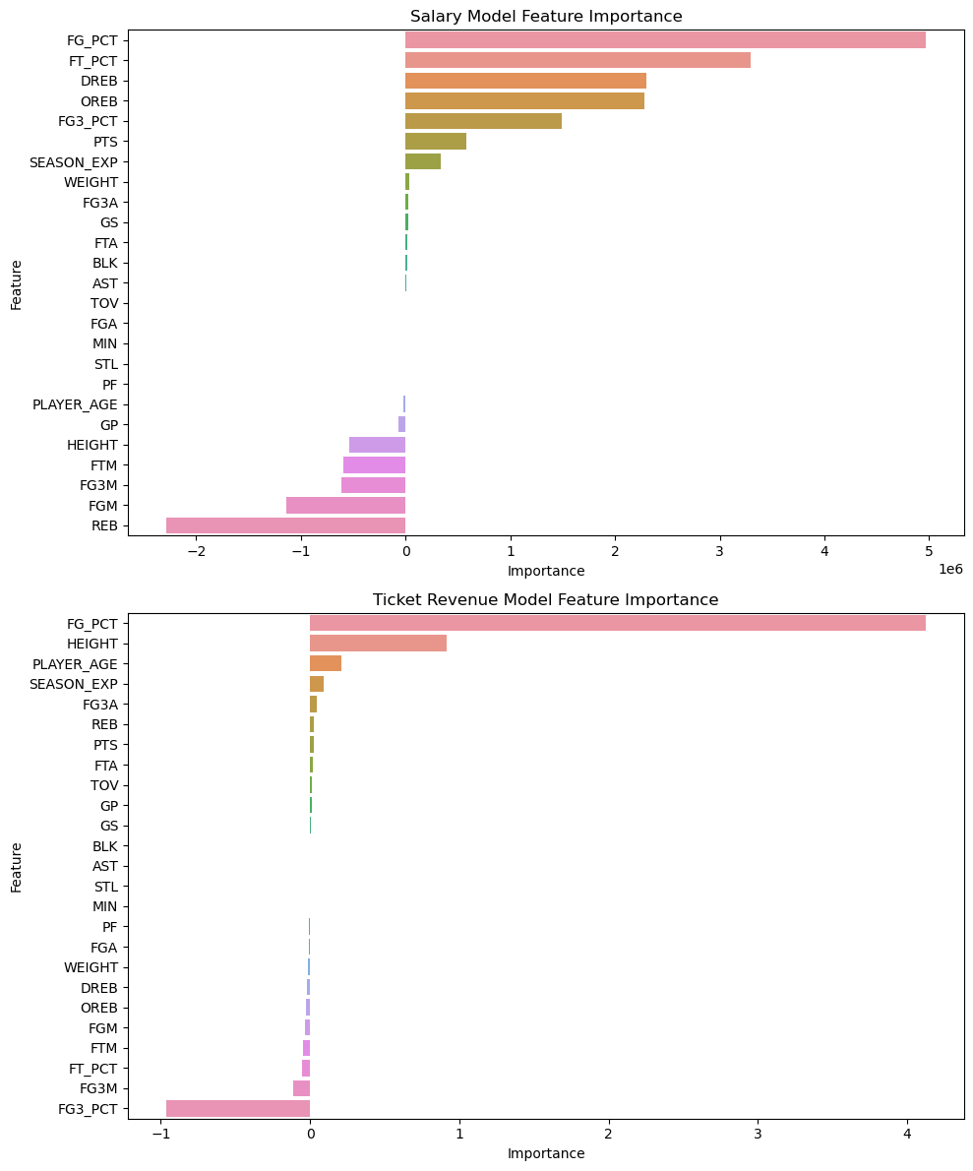
Analysis (Regression)
The Field Goal Percentage and Free Throw Percentage seem to be the most important features for the linear regression model.
Rebounds is the least important feature, rebounding is lowly valued in the player's evaluation.
Players who score more goals, as opposed to assists, typically earn more.

Slide 32
Conclusions
The correlation between a player's salary and observable performance metrics, such as points scored, along with physical characteristics like height and weight, is quite weak. This could be due to the model's lack of accuracy
This indicates that historical NBA player salaries have been largely determined by other actors not considered in this study
For example, unobservable/unquantifiable qualities such as a player’s personality or performance under pressure may be important factors in determining a player’s value
Overall, these findings are surprising because we would expect that higher player performance would have a stronger influence on that player’s salary
This is because higher player performance means higher team performance which should theoretically be the ultimate goal of an NBA front office

Slide 33
Recommendations
Given these findings, our recommendations to the various stakeholders are as follows:
NBA Team Front Office: Take player performance (stats) into account more than you are currently. While it is not the only factor that makes a player valuable, it is vital to team success and should carry more weight in your valuation
NBA Coaches: Look for players that fit your team culture and are high performing. Given our findings, you might be able to get a good deal on a talented player with attitude problems.
NBA Players: Teams do not appear to value good statistics as much as one might expect. In your negotiations, emphasize your off-the-court strengths such as being a good teammate, a hard worker, or cool under pressure as these less observable attributes appear to be more important.
NBA Fans: Don’t despair if your team seems to sign a less-talented player than you wanted. Statistics are less important than cultural fit which can be hard to observe as a fan.

Slide 34
References
Curcic, Dimitrije. “NBA Revenue Statistics (2001-2022).” RunRepeat, 1 Nov. 2023, runrepeat.com/nba-revenue-statistics.
Keane, Sean. “The Worst NBA Contracts of All Time.” Yardbarker, 5 Dec. 2023, www.yardbarker.com/nba/articles/the_worst_nba_contracts_of_all_time_120123/s1__29861057.
Patel, Swar. “Swar/NBA_API: An API Client Package to Access the Apis for Nba.Com.” GitHub, 2023, github.com/swar/nba_api/tree/master.
“These Are the Salaries of All NBA Players.” HoopsHype, HoopsHype, 2023, hoopshype.com/salaries/players/.
“Total NBA League Revenue 2023.” Statista, Statista Research Department, 28 Nov. 2023, www.statista.com/statistics/193467/total-league-revenue-of-the-nba-since-2005/#:~:text=Total%20revenue%20of%20the%20National%20Basketball%20Association%202001%2D2023&text=During%20the%202022%2F23%20season,dollars%20from%20the%20previous%20year.

Slide 35
Appendix

Slide 36
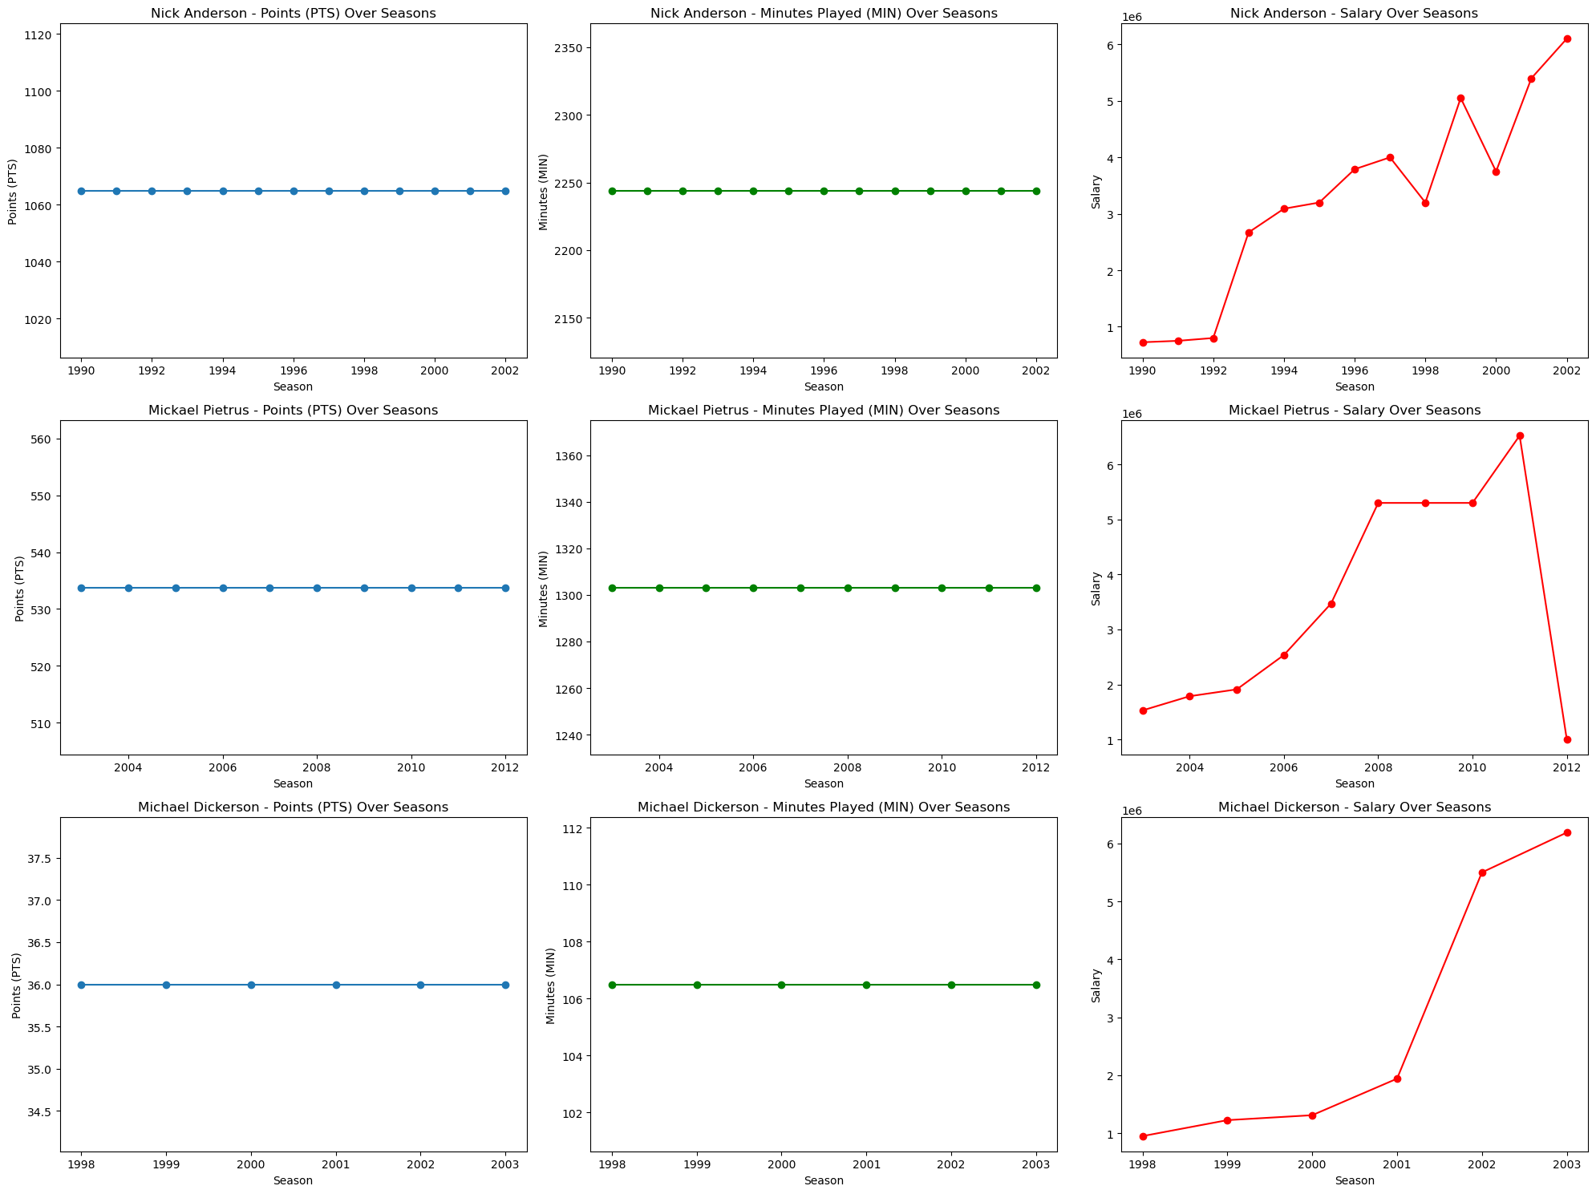
Appendix
Model Score:
Random Forest | 0.23102686160960192
Gradient Boosting | 0.24692499659255357
Support Vector Regression | -0.14201036832171354
Ridge Regression | 0.21386222890703327
Lasso Regression | 0.21406322152894894

Slide 37
Appendix

Slide 38
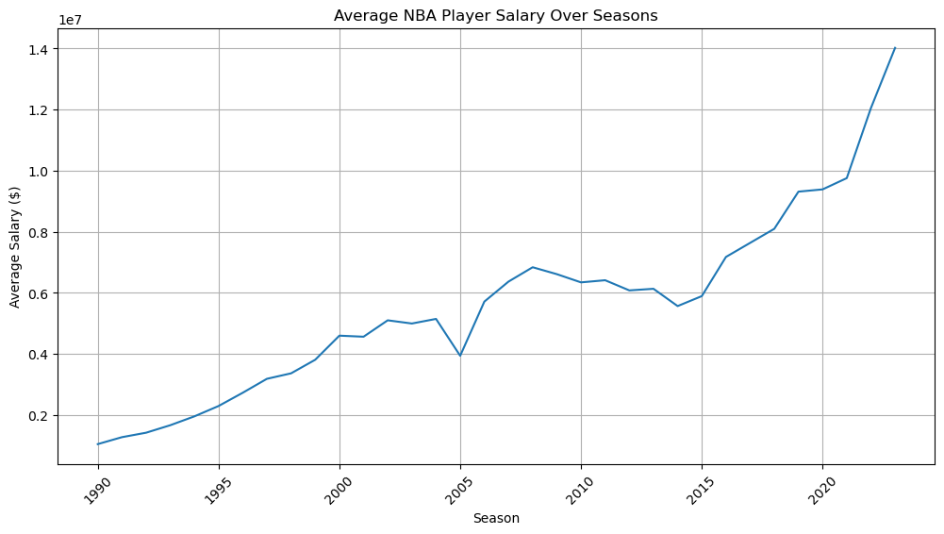
Appendix

Slide 39
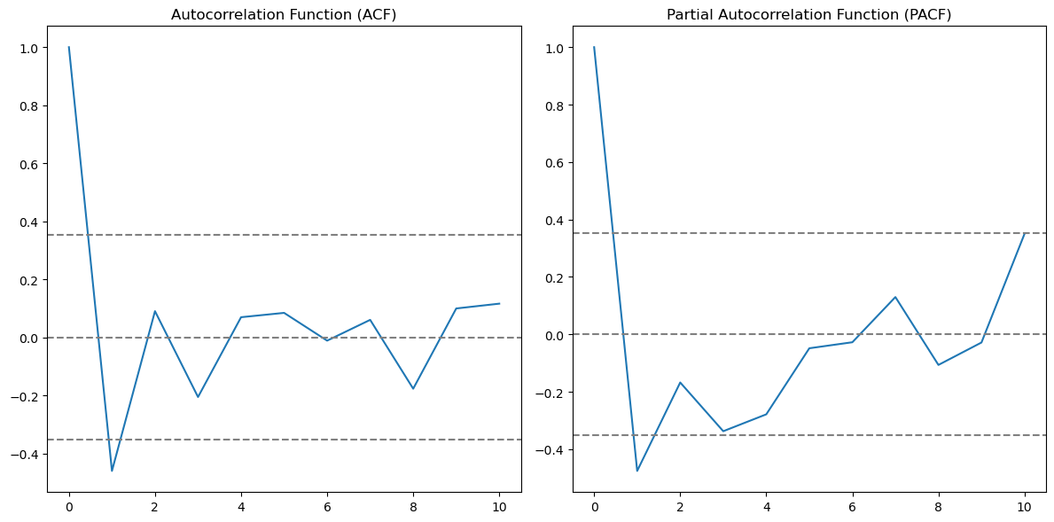
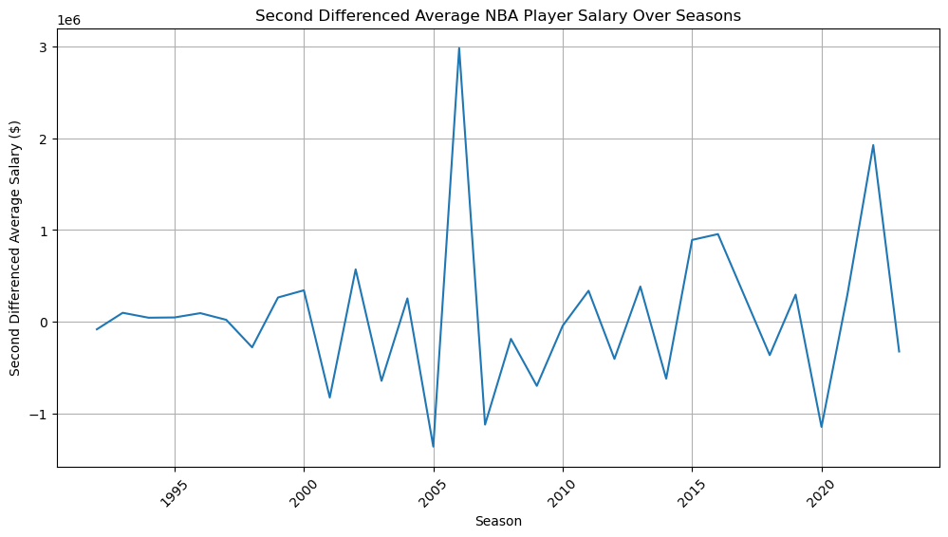
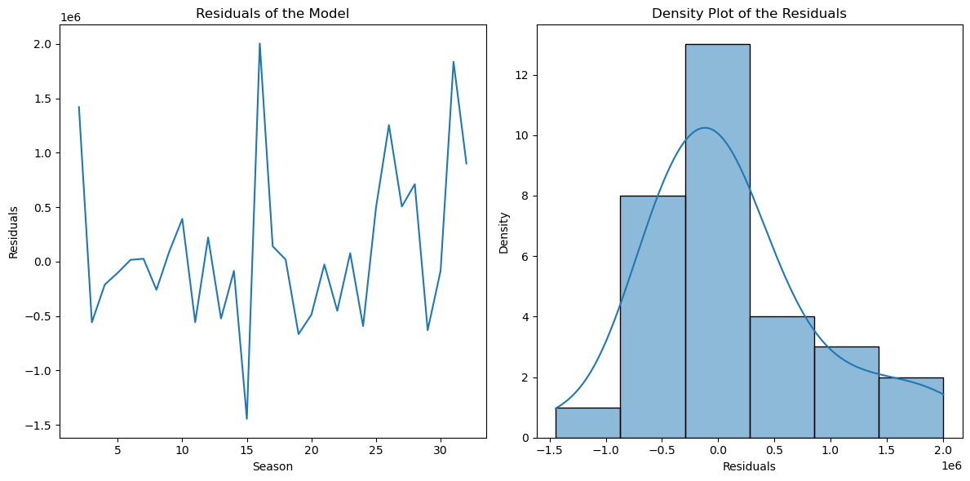
Appendix

Slide 40
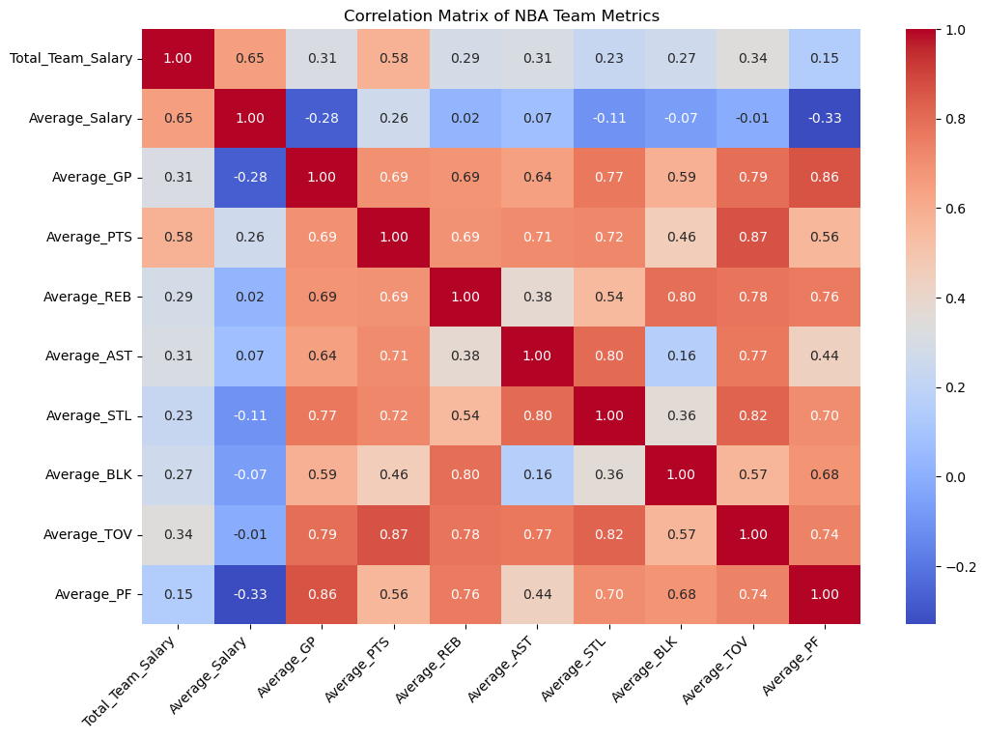
Appendix

